Slide 1

Pedanto - Modelling An attentitive Ux/UI
For Online Learning

Slide 2
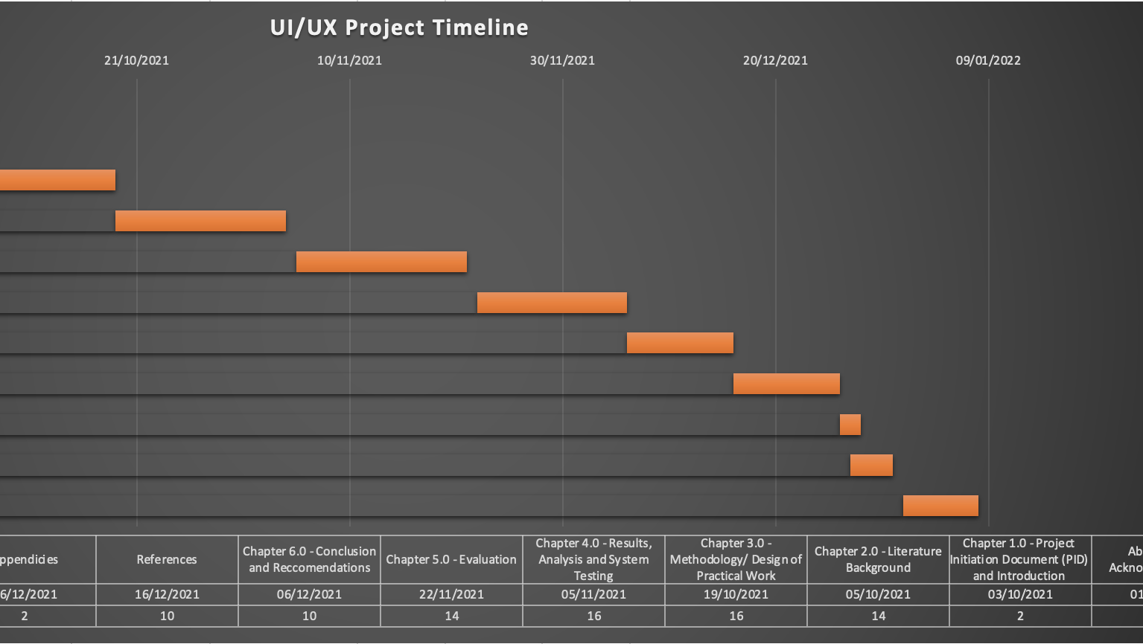
Project Initiation Document (PID), Plan and Introduction
PID and Project Plan
WBS Timescale
Gantt Chart
Objectives
Approach
Scope and Constraints
Introduction to modelling UX/UI for online learning

Slide 3
The Projects Objectives:
To provide an adequate project planning
To model attentive UX/UI for online learning platforms (Zoom, Microsoft Teams, WebEx, Skype, Google Chat (Meet, Google Classroom etc.), TeamViewer, Blink, and others).
To analyse up to seven of the above-mentioned tools will be chosen for comparison and examination of their features.
What are their limitations and what other features do they provide?
Creating an IT project prototype – python/HTML/CSS script.
IT project prototype would follow proper software methodology (Waterfall or Agile model, or possibly a mix of both).

Slide 4
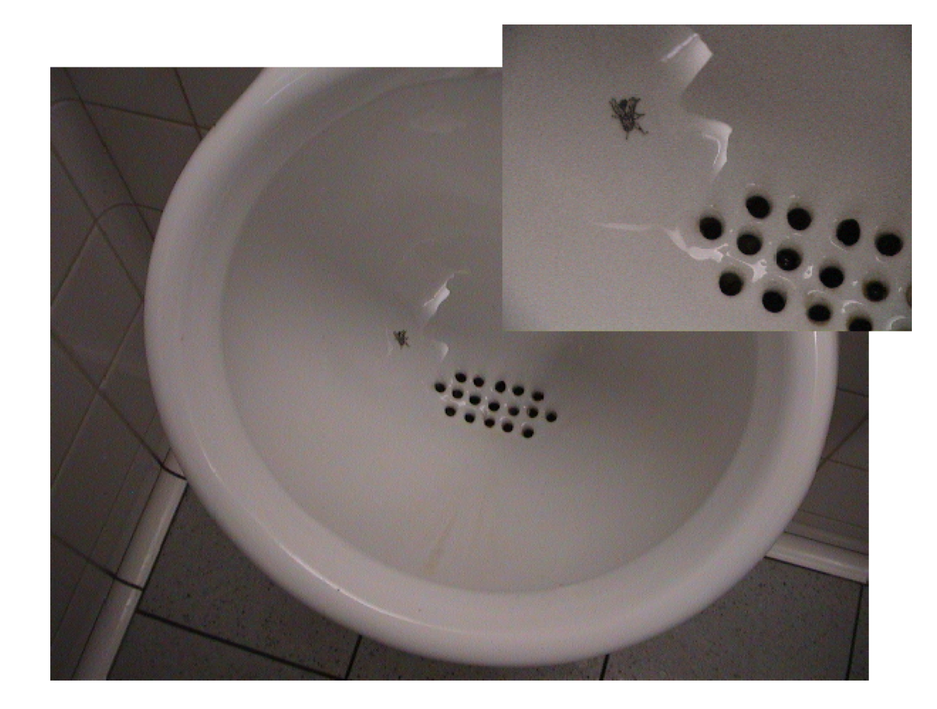
Introduction to modeling UX/UI for online Learning
Introducing the concept of UX/UI design
UX/UI design in the context of a computing project
Competitive analysis of the computing project
How to define the product prototype?

Slide 5
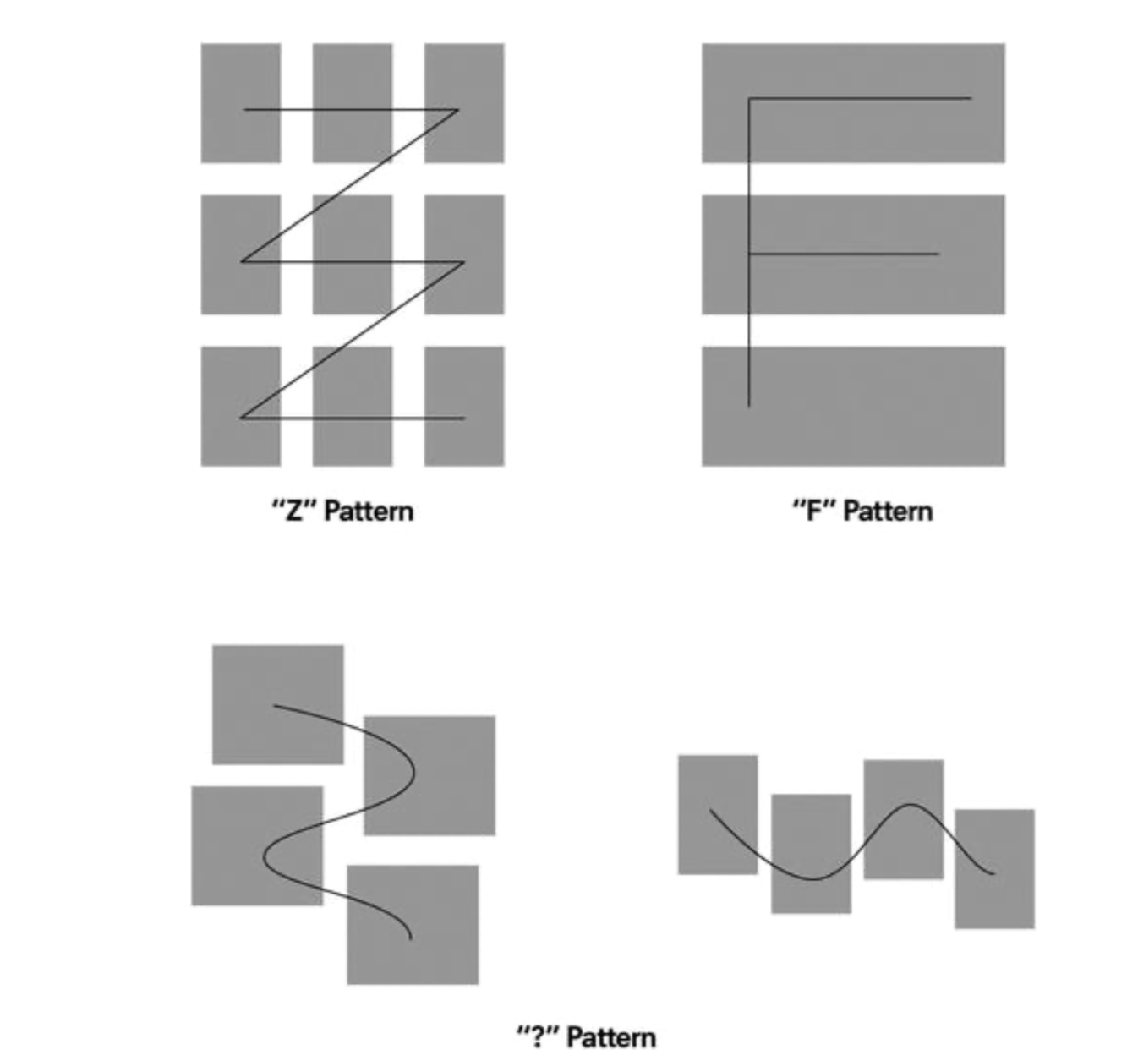
Prototype Pattern

Slide 6
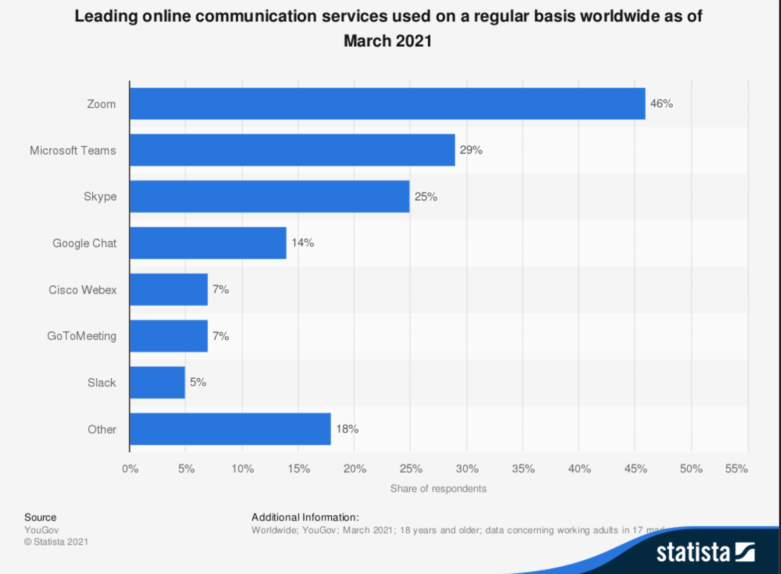
Online communication interfaces comparison

Slide 7
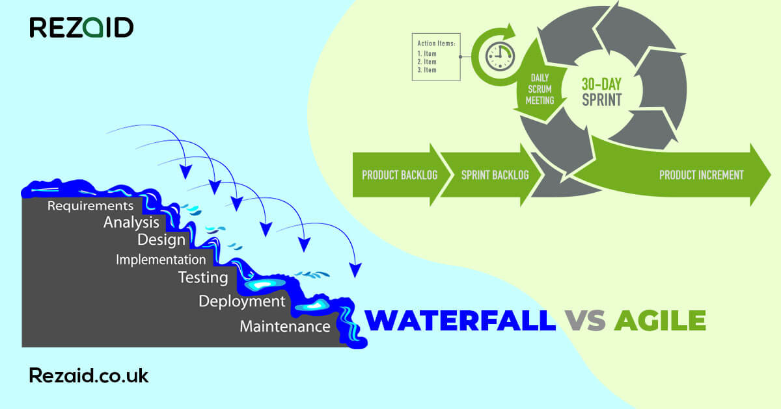
Research and Project Methodology
Research Philosophy
Research Approach
Project management methodology assessment
Principles of Agile (SLDC, Scrum practices and Lean and Agile UX/UI)

Slide 8

Design of Practical Work : Design Approach
Default
Mimicry
Fiat

Slide 9

Design of Practical Work : UX/UI Design for Desktop
The design of the web application itself
HTML & CSS Code

Slide 10

Survey
Survey based on the features of the web application

Slide 11

Critical evaluation and reflection of professional, social, ethical and security issues regarding online learning in a context of the attentive UX/UI prototype (Guidance for Deployment and Maintenance)
Security and privacy issues
Social and ethical issues
Ethical and legal issues

Slide 12
Recommendations and Conclusion
Recommendations in the context of attentive UX/UI’s for online learning
Things to consider
Remote monitoring system
Conclusion

Slide 13
References
Brown, T. & Wyatt, J. (2010) Design thinking for social innovation. Available at:
https://ssir.org/articles/entry/design_thinking_for_social_innovation (Accessed: 16/1/2022)
Cabrera, J. (2017) Modular Design Frameworks. 1st edn. Holbrook, NY: Springer Science
Khan, S., (2019) Agile vs Waterfall: which is the better software development. Available at:
https://rezaid.co.uk/agile-waterfall-software-development/ (Accessed: 16/1/2022)
Ocean Point Insurance (2022) 8 COMMON HACKING TECHNIQUES THAT EVERY BUSINESS OWNER SHOULD KNOW ABOUT. Available at:
https://www.oceanpointins.com/ri-business-insurance/cyber-liability-insurance/8-common-hacking-techniques/ (Accessed: 16/1/2022) Statista (2022) Leading video calling platforms used for virtual experiences in 2020. Available at:
https://www.statista.com/statistics/1266327/video-calling-technology-platforms-virtual-experiences/ (Accessed: 17/11/2021)
Vertegaal, R. (2002) “Designing attentive interface”, ACM Journals. 1(1), pp. 1-9. DOI: 10.1145/507072.507077

